Slide 1
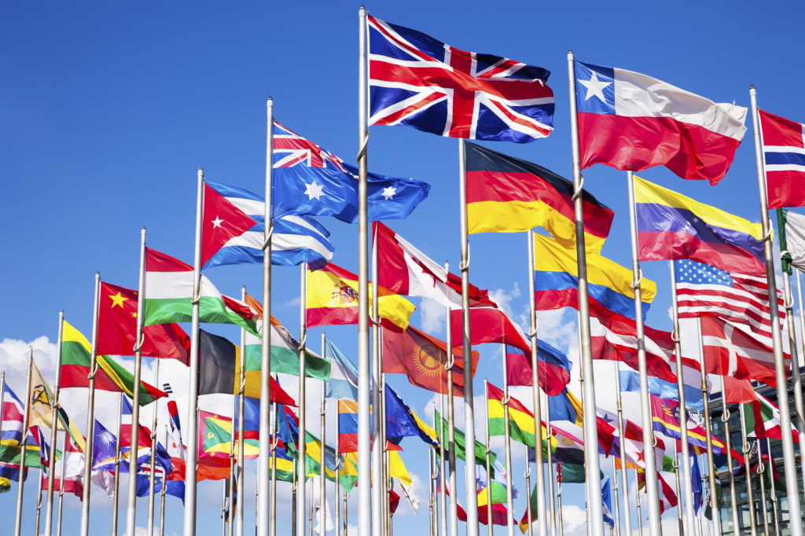
Application of Data Science in Governance
Omolara Illoh
ESIEE University Paris
March 2018

Slide 2
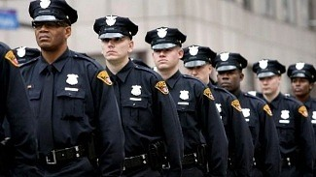
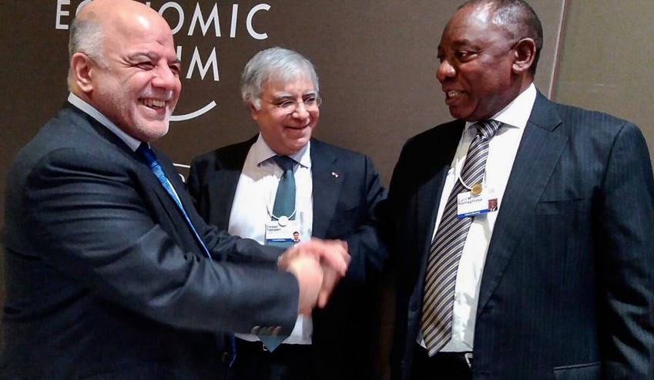
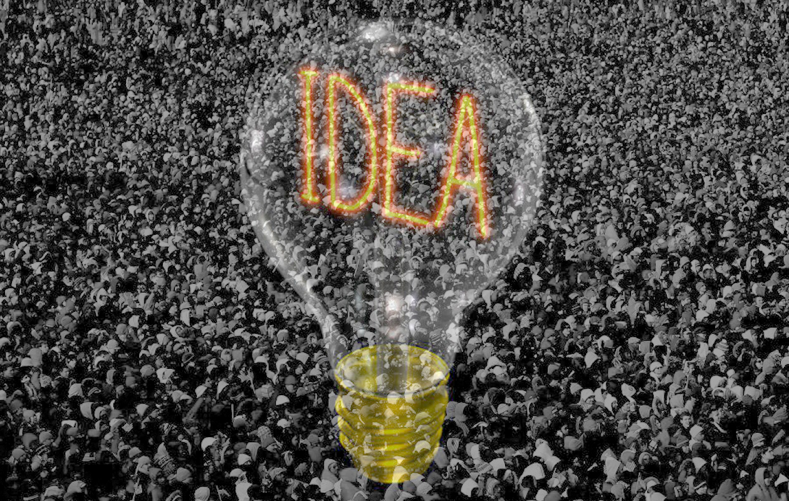

Recent Areas of Application
Intelligence gathering
AI Precision
Scanners
Espionage
Interference in
democratic processes
National
Security
Foreign
Policy
Crowd-sourcing
Legislative reforms
Constitutional reforms
Political Pressure
Voter manipulation
AI Politician - SAM
Civic
Engagement
National
Politics

Slide 3
References
https://www.kaggle.com/c/passenger-screening-algorithm-challenge
https://www.google.fr/amp/s/www.ndtv.com/offbeat/worlds-first-ai-politician-developed-1780166%3famp=1&akamai-rum=off
https://www.weforum.org/agenda/2017/08/artificial-intelligence-can-save-democracy-unless-it-destroys-it-first/
https://www.campaignsandelections.com/videos/data-analytics-and-the-future-of-political-campaigning

